Slide 1

What is Data Science?
Atul Kumar (12102801)
Master of Computer Application
Lovely Professional University,
Phagwara, Punjab, India

Slide 2
Outline
Data, Big Data and Challenges
Data Science
Introduction
Why Data Science
Data Scientists
What do they do?
Major/Concentration in Data Science
What courses to take.

Slide 3




Data All Around
Lots of data is being collected and warehoused
Web data, e-commerce
Financial transactions, bank/credit transactions
Online trading and purchasing
Social Network

Slide 4
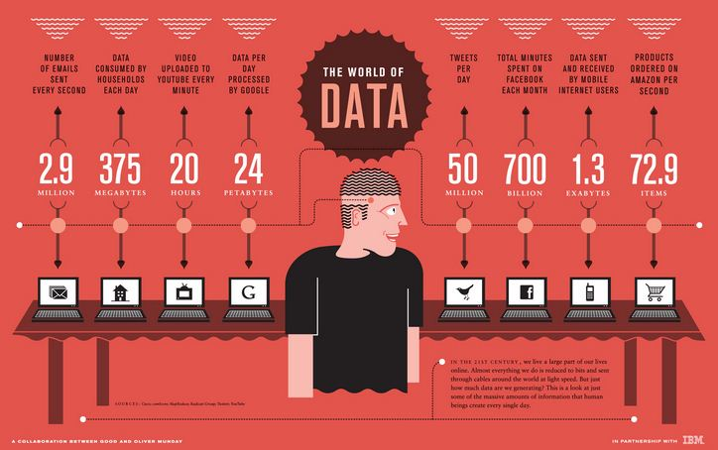
How Much Data Do We have?
Google processes 20 PB a day (2008)
Facebook has 60 TB of daily logs
eBay has 6.5 PB of user data + 50 TB/day (5/2009)
1000 genomes project: 200 TB
Cost of 1 TB of disk: $35
Time to read 1 TB disk: 3 hrs
(100 MB/s)

Slide 5
Big Data
Big Data is any data that is expensive to manage and hard to extract value from
Volume
The size of the data
Velocity
The latency of data processing relative to the growing demand for interactivity
Variety and Complexity
the diversity of sources, formats, quality, structures.

Slide 6
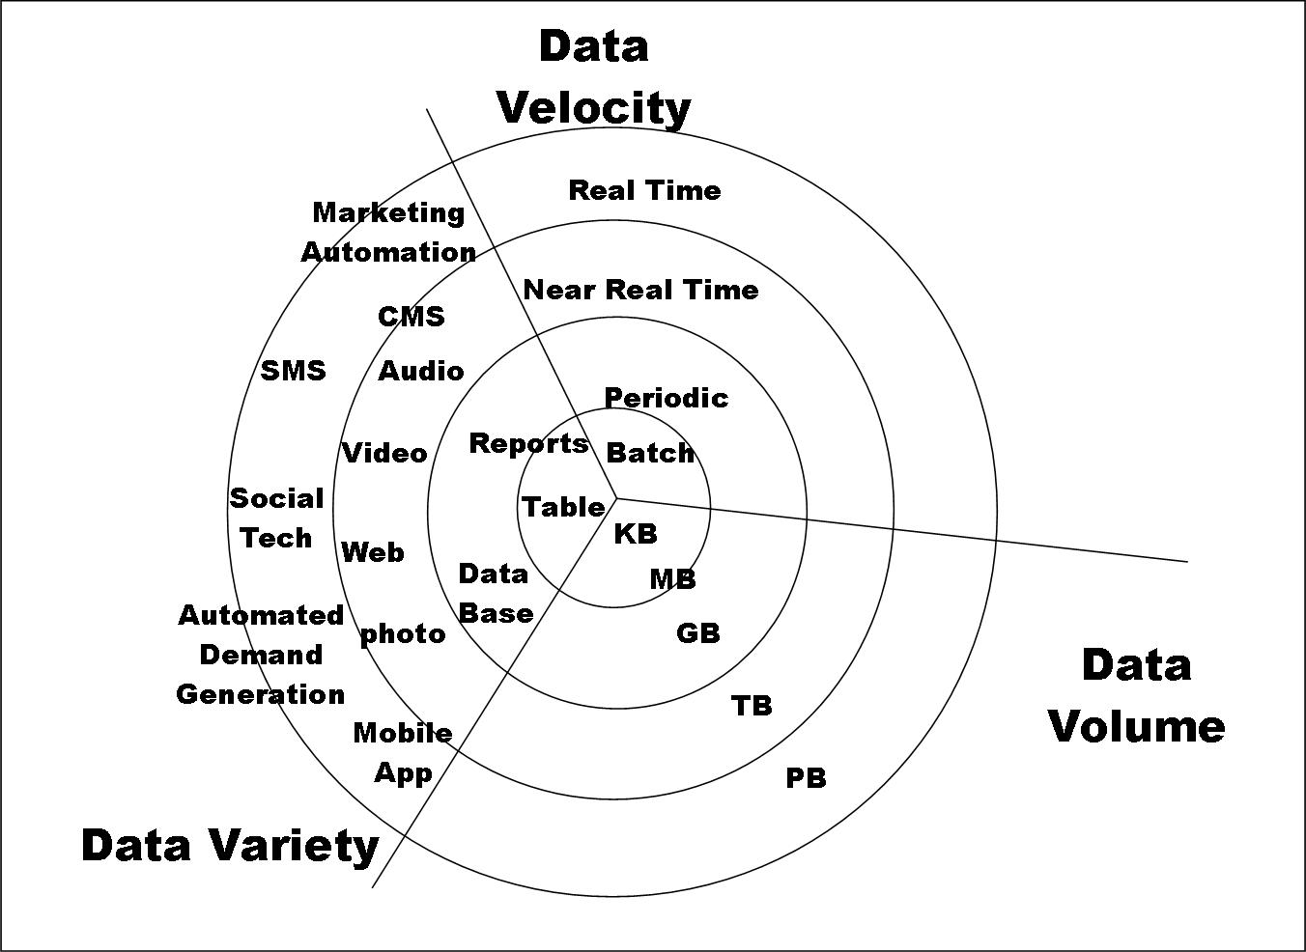
Big Data

Slide 7
Types of Data We Have
Relational Data (Tables/Transaction/Legacy Data)
Text Data (Web)
Semi-structured Data (XML)
Graph Data
Social Network, Semantic Web (RDF), …
Streaming Data
You can afford to scan the data once

Slide 8
What To Do With These Data?
Aggregation and Statistics
Data warehousing and OLAP
Indexing, Searching, and Querying
Keyword based search
Pattern matching (XML/RDF)
Knowledge discovery
Data Mining
Statistical Modeling

Slide 9
Big Data and Data Science
“… the sexy job in the next 10 years will be statisticians,” Hal Varian, Google Chief Economist
The U.S. will need 140,000-190,000 predictive analysts and 1.5 million managers/analysts by 2018. McKinsey Global Institute’s June 2011
New Data Science institutes being created or repurposed – NYU, Columbia, Washington, UCB,...
New degree programs, courses, boot-camps:
e.g., at Berkeley: Stats, I-School, CS, Astronomy…
One proposal (elsewhere) for an MS in “Big Data Science”

Slide 10
What is Data Science?
An area that manages, manipulates, extracts, and interprets knowledge from tremendous amount of data
Data science (DS) is a multidisciplinary field of study with goal to address the challenges in big data
Data science principles apply to all data – big and small

Slide 11
What is Data Science?
Theories and techniques from many fields and disciplines are used to investigate and analyze a large amount of data to help decision makers in many industries such as science, engineering, economics, politics, finance, and education
Computer Science
Pattern recognition, visualization, data warehousing, High performance computing, Databases, AI
Mathematics
Mathematical Modeling
Statistics
Statistical and Stochastic modeling, Probability.

Slide 12
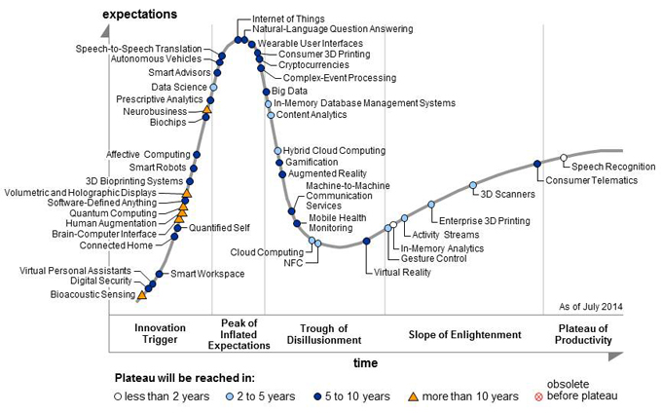
Why is it sexy?
Gartner’s 2014 Hype Cycle

Slide 13
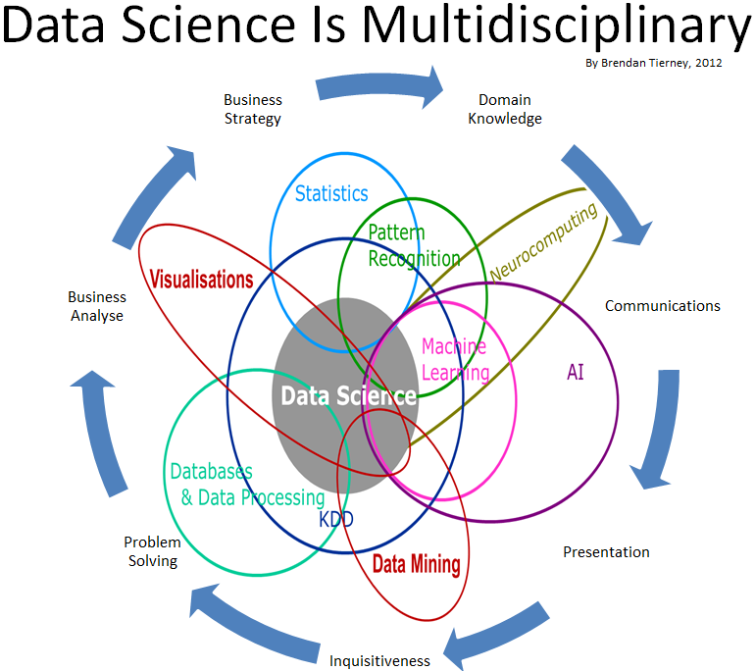
Data Science

Slide 14
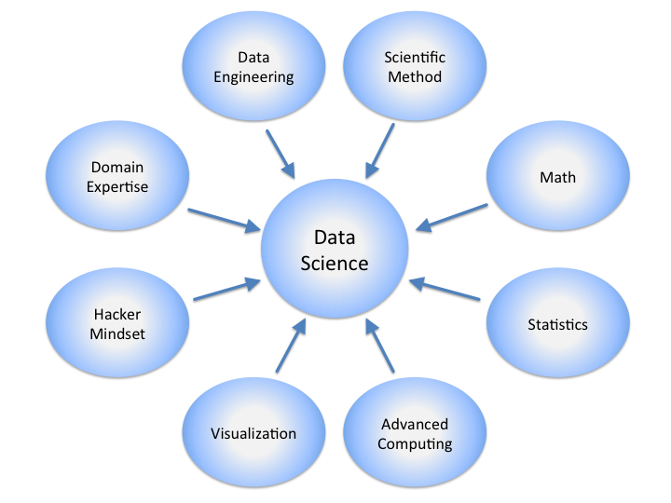
Data Science

Slide 15
Real Life Examples
Companies learn your secrets, shopping patterns, and preferences
For example, Companies don’t need to ask you if you’re pregnant, they know from the change in your purchases. And sometimes they even know you’re pregnant before you do
Data Science and election (2008, 2012)
1 million people installed the Obama Facebook app that gave access to info on “friends”
Source: New York Times

Slide 16

Data Scientists
Data Scientist
The Sexiest Job of the 21st Century
They find stories, extract knowledge. They are not reporters

Slide 17

Data Scientists
Data scientists are the key to realizing the opportunities presented by big data. They bring structure to it, find compelling patterns in it, and advise executives on the implications for products, processes, and decisions

Slide 18
What do Data Scientists do?
National Security
Cyber Security
Business Analytics
Engineering
Healthcare
And more ….

Slide 19
Concentration in Data Science
Mathematics and Applied Mathematics
Applied Statistics/Data Analysis
Solid Programming Skills (R, Python, Julia, SQL)
Data Mining
Data Base Storage and Management
Machine Learning and discovery

Slide 20
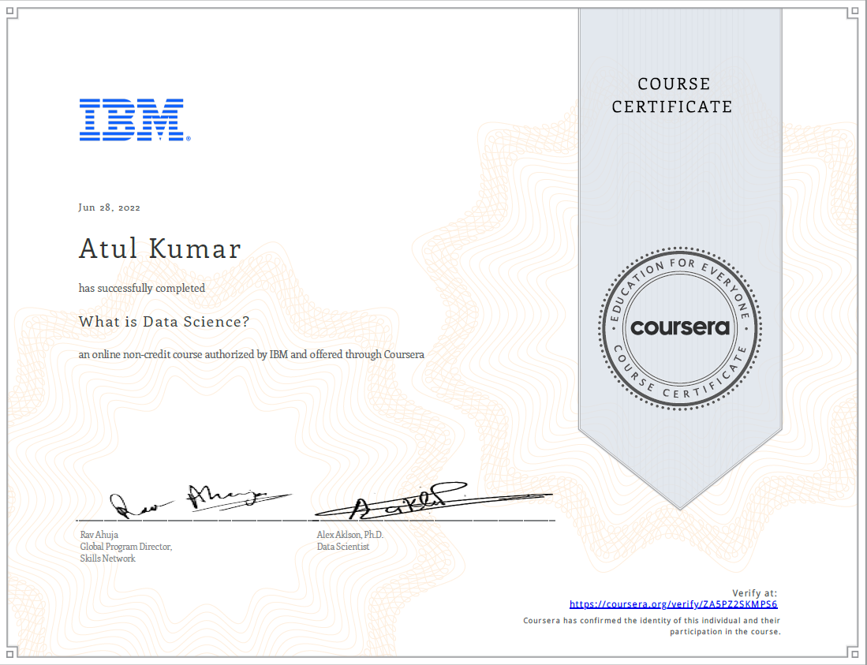
Course Certificate
Name: What is Data Science?
Issuing Organization: Coursera
Issue Date: June 2022
Expiration Date: This certification does not expire
Credential ID: ZA5PZ2SKMPS6
Credential URL: https://www.coursera.org/account/accomplishments/certificate/ZA5PZ2SKMPS6

Slide 21

THANK YOU

